Slide 1

Web Deployment
Asst.Prof.Dr.Derya BİRANT
328 - Web Based Windows Programming

Slide 2
Contents
1
What is Web Deployment?
2
Internet Information Services (IIS)
3
Deploying a WebSite

Slide 3




What is Web Deployment?
When the coding and testing is complete and it is time to publish your work to the WORLD ! ☺
Your application is now available worldwide !
Many people will use your web application !

Slide 4
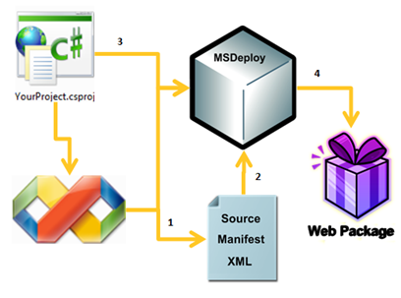
What is Web Deployment?
Web deployment means a deployment to a single hardware web server that identified by a single IP/DNS address.

Slide 5
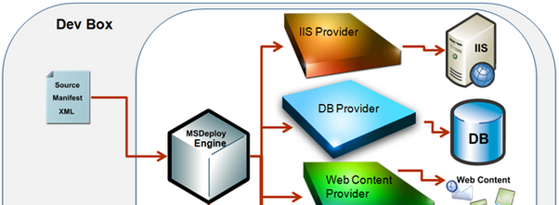

Internet Information Services (IIS)
For ASP.NET, the server is Internet Information Services (IIS)
IIS supports for hosting ASP.NET applications.

Slide 6
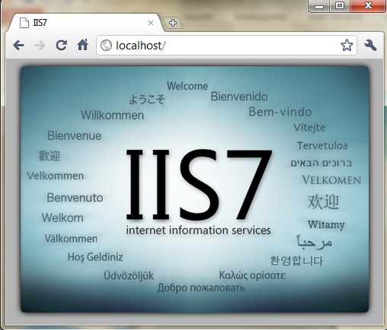
Internet Information Services (IIS)
Windows Server 2008 and Windows Vista run IIS version 7.0, while Windows Server 2008 R2 and Windows 7 run IIS version 7.5.
Write "localhost" in a browser.

Slide 7
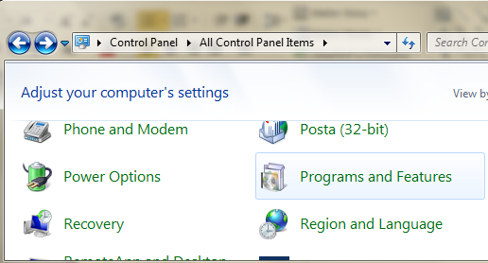
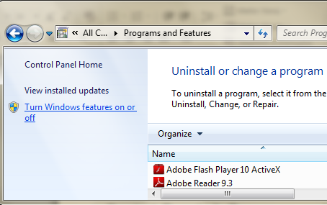
Installing IIS
IIS is included as part of the installation of Windows.
Control Panel → Programs and Features → Turn Windows features on or off

Slide 8
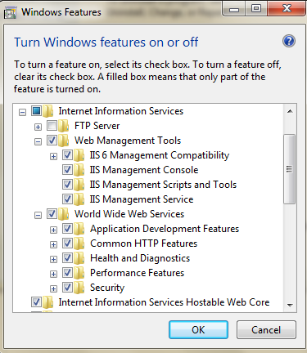
Installing IIS
Select IIS and then click OK button.

Slide 9
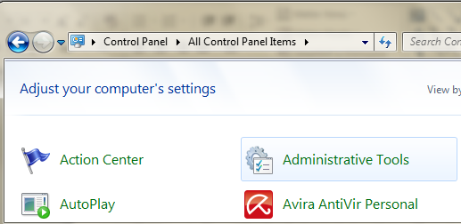
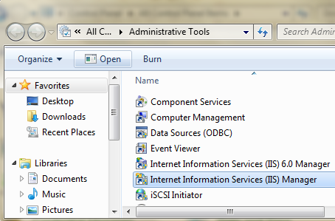
Managing IIS 7
Control Panel → Administrative Tools →

Slide 10
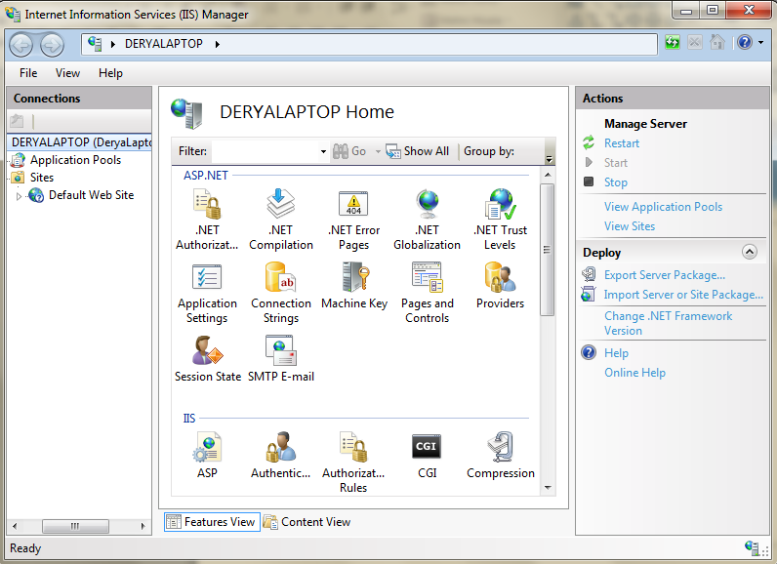
Managing IIS 7

Slide 11
Managing IIS 7
It presents a series of icons that allow you to configure the settings for your server.
On the right side of the screen → a series of actions.
You can start, stop, and restart your server.
The tree control on the left of the screen → an item named Sites, which contains a single entry called Default Web Site.
A site is a collection of files and directories that make up a website. IIS can support multiple sites on a single server, typically on different TCP/IP ports (the default being port 80).

Slide 12
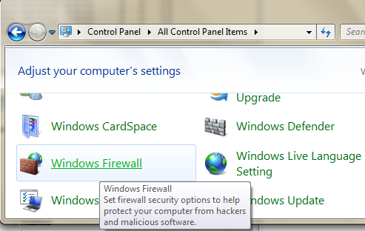
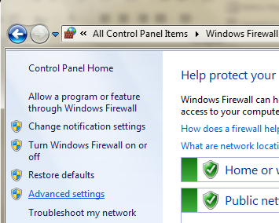
Opening Port 80
Control Panel → Windows Firewall → Advanced Settings →

Slide 13
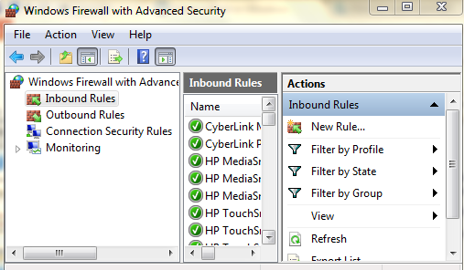
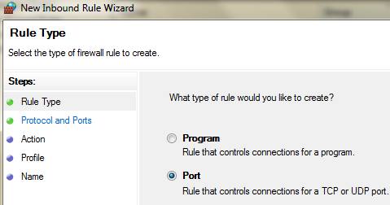
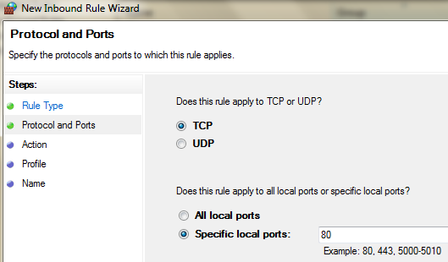
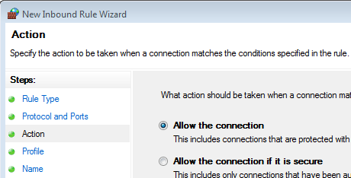
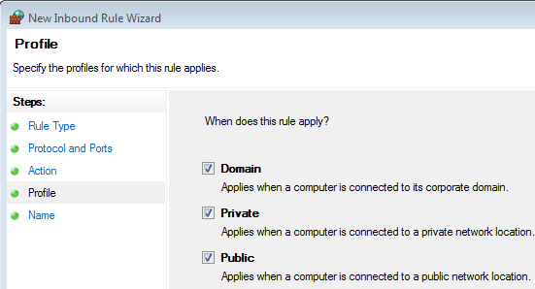
Opening Port 80 (Windows 7)
Control Panel → Windows Firewall → Advanced Settings →
InboundRules → New Rule →Ports → 80

Slide 14
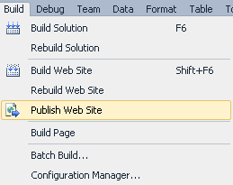
Deploying a Website - I
Open the website project
Click Build menu
Select the Publish Web Site item

Slide 15
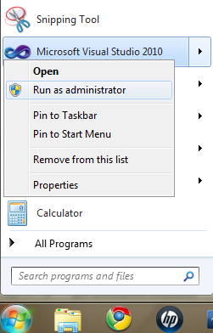
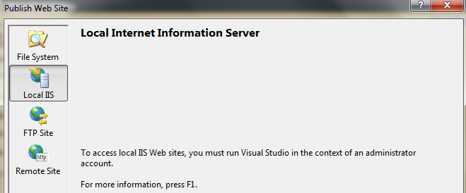
Deploying a Website - II
Run as administrator

Slide 16
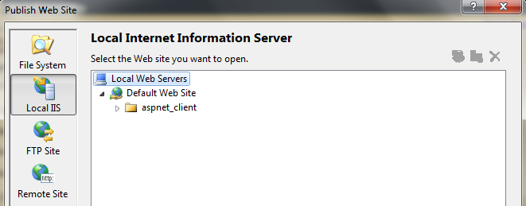
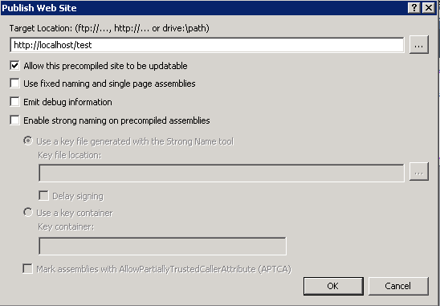
Deploying a Website - III
http://localhost/test

Slide 17
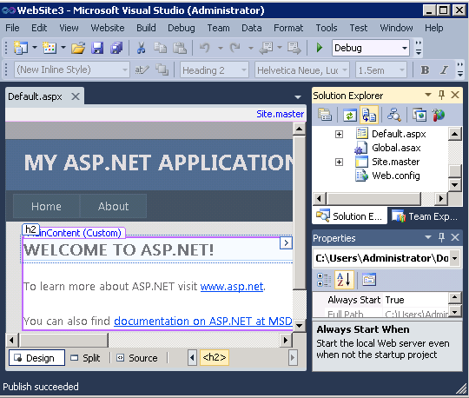
Deploying a Website - IV
"Publish succeeded" message

Slide 18
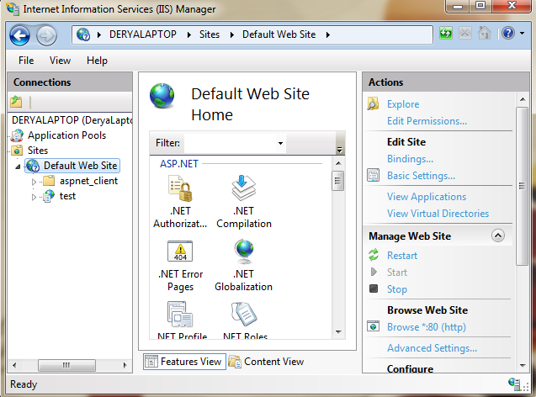
After Web Deployment
After publish, Default Web Site contains virtual directory

Slide 19
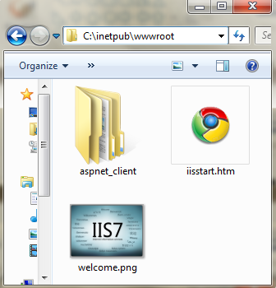
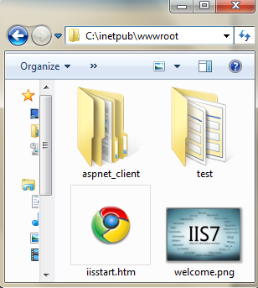
After Web Deployment
C:\inetpub\wwwroot

Slide 20
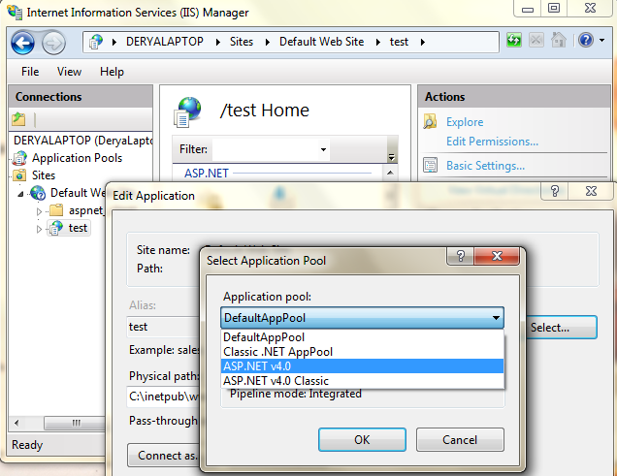
After Web Deployment

Slide 21
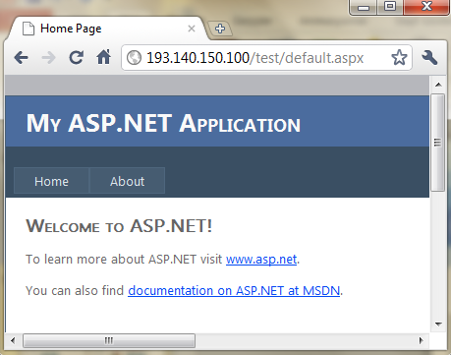

Access to the WebSite
Use a web browser to access to the website you published

Slide 22
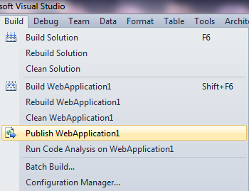
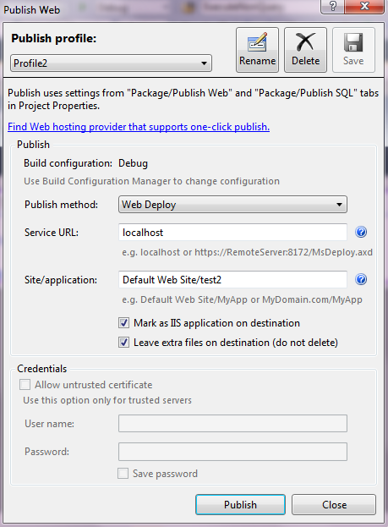
Publishing Web Application

Slide 23
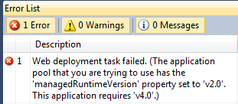
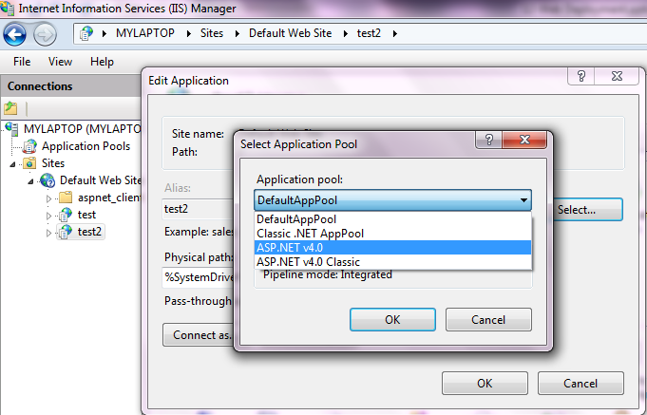
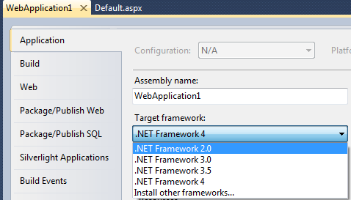
Error
Solution 1
Solution 2

Slide 24
See you next week!
Asst.Prof.Dr.Derya BİRANT
328 - Web Based Windows Programming

